Slide 1
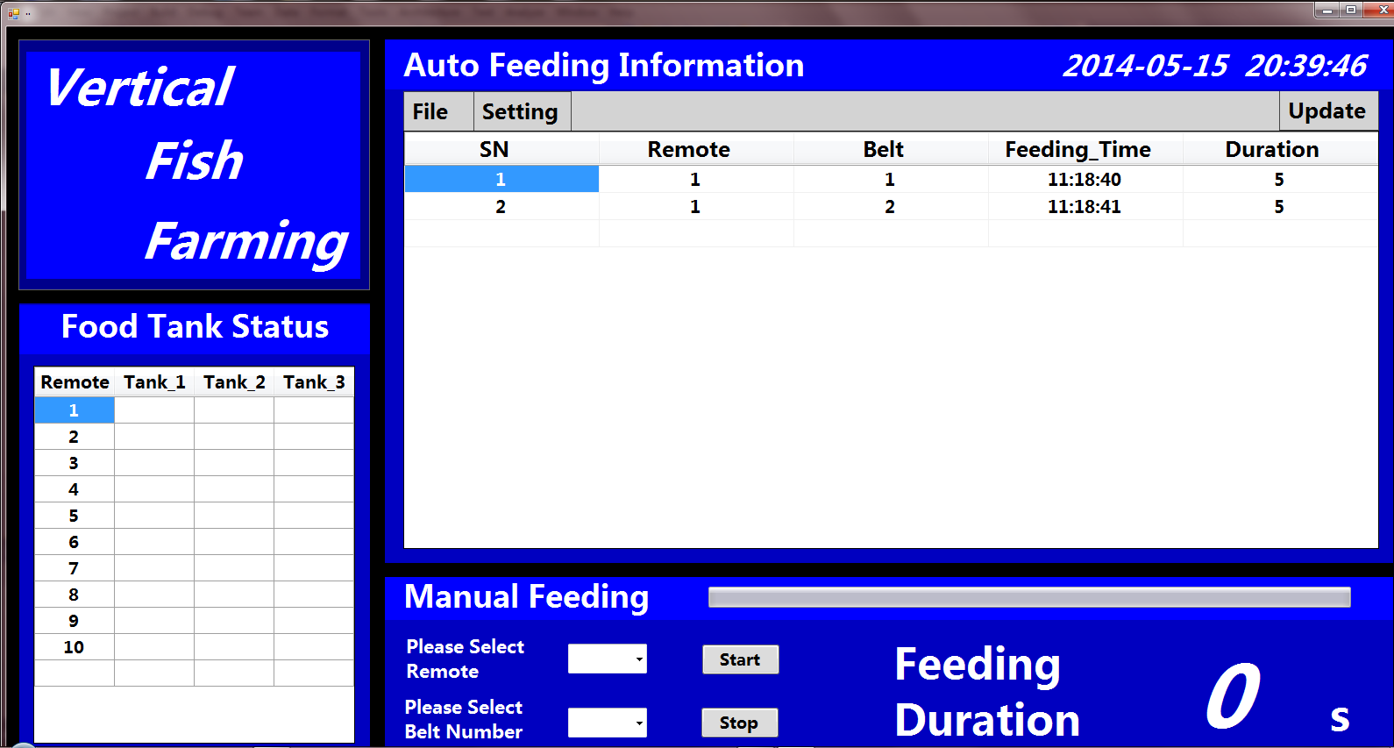
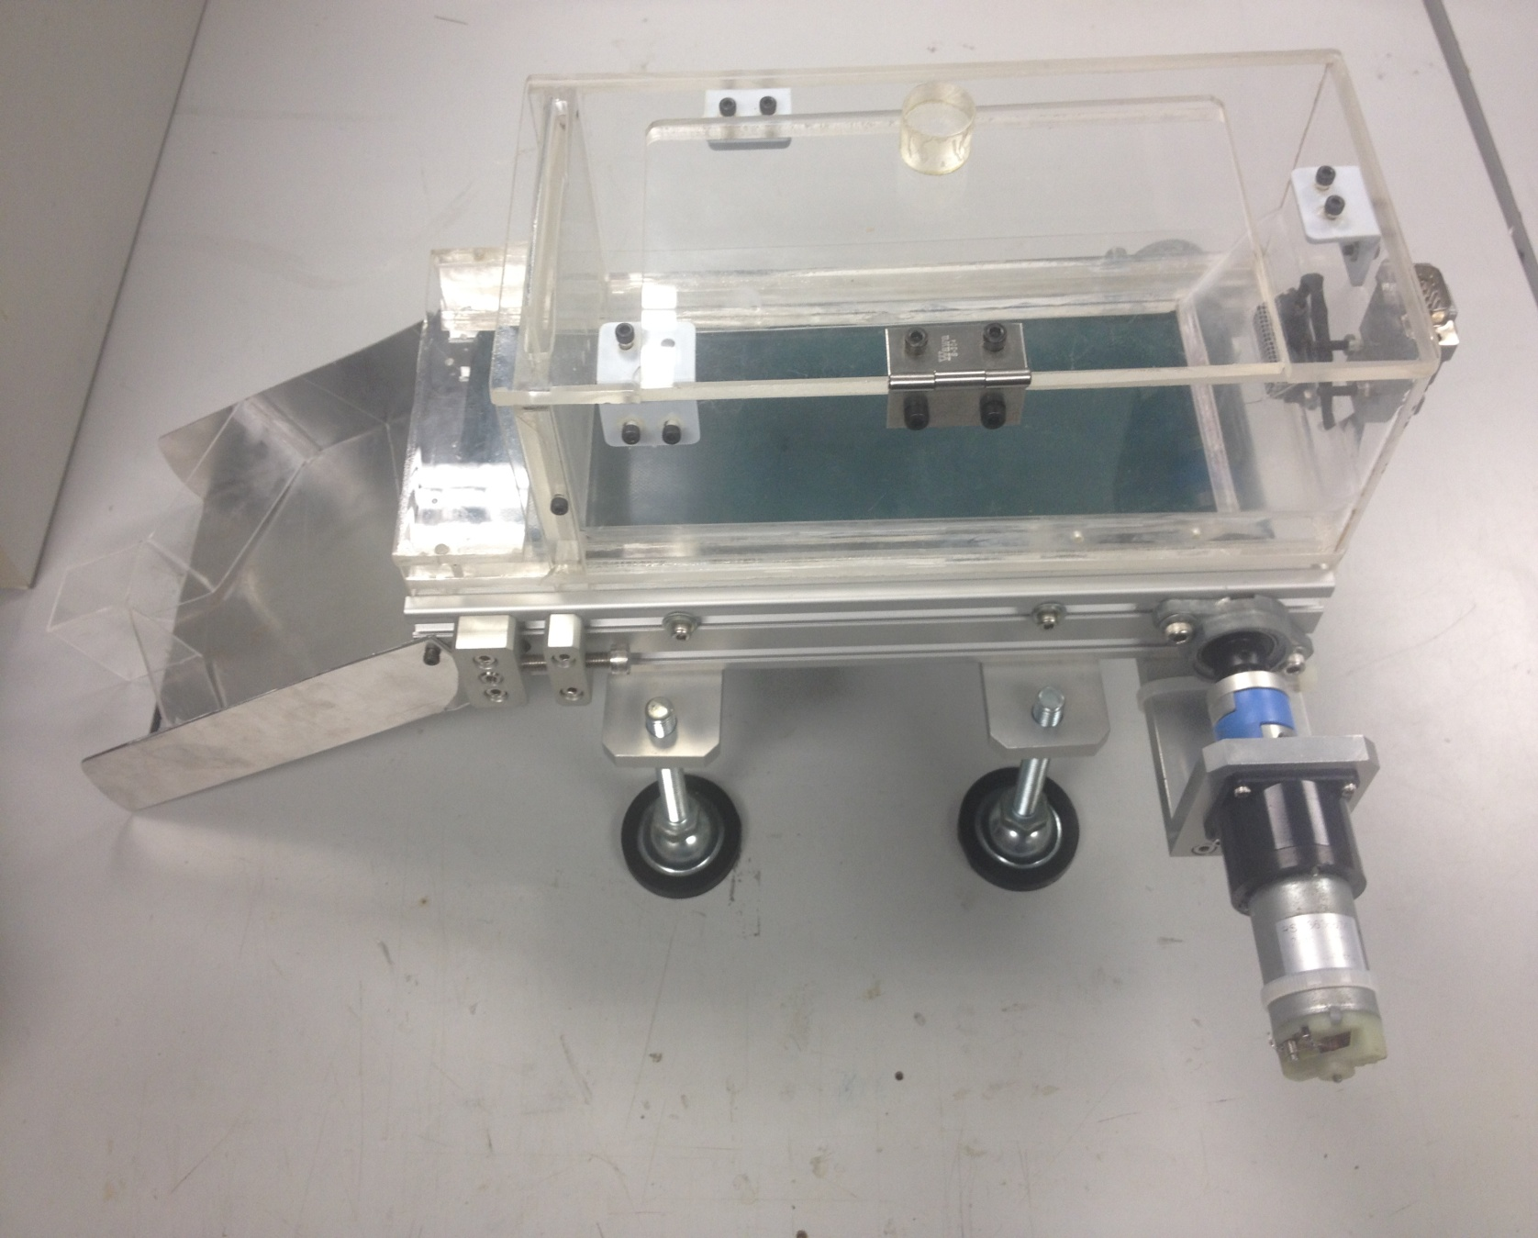

Vertical Fish Farming
Project No: 2B13049
Students: Wang Pengfei, Xu Sheng & Zhang Sheng
Supervisor: Mr. Foong Chee Hoong (1st supervisor) & Ms. Tay Sioh Hoong (2nd supervisor)
Project Description
This project was to develop an automated Fish Farming system, the feeding process was manipulated by a PC Control. This PC Control can control many fish tanks at remote area, via a router, using wireless Wi-Fi embedded in a Remote Wireless module. This system can increase the efficiency of feeding fish, in terms of space, manpower, energy and time. It is specially designed for fish farming industry.
User Interface
Key Features
Presents user-friendly interface
Provides automatic fish feeding according to the preset time
Allows remote control by using central PC and Host Module controller
Monitors the food level in the food container
Food Container Prototype
Embedded System Diploma Unit
Notes:
White Background
Vertical Photo Display

